Slide 1
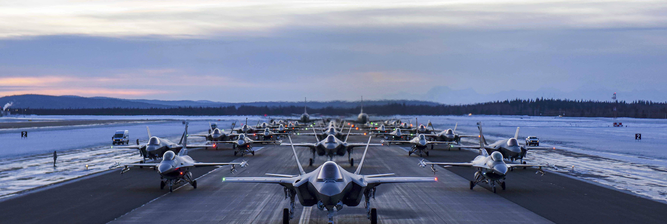
We Want to Hear from You!
Ms. Nancy J Balkus
Deputy Assistant Secretary of the Air Force for Environment, Safety and Infrastructure
Invites YOU to attend
The Alaska Micro-reactor Pilot Program
Community Meeting Panel and Public Q&A!
Moderated by Fairbanks North Star Borough Mayor Bryce Ward
We hope to see you there!
Please direct any questions regarding this event to
SAF.IEE.Micro-ReactorPilot@us.af.mil
Thursday, August 31st, 5:00-6:00 PM
Druska Schaible Auditorium
Joseph E. Usibelli Building
1764 Tanana Loop, Fairbanks, AK

